Slide 1
JAVA OO-PROJECT
GOALS,Purposes, USER STORIES
Mikko Niskanen

Slide 2
Goals, Purposes
The goal of this project was to create an encryption application which uses the AES algorithm for encryption and decryption. One of the main goals was to let the users decide their own key for this encryption so that the application can be as secure as possible.

Slide 3
User Stories
Users can Encrypt any text they wish and set any key for the encryption. The AES algortihm takes the bytes out of the key and encrypts the text with it.
After the encryption users can either decrypt what ever they just encrypted, as long as the key remains the same, or they can Save the encrypted/decrypted text to a file which will be contained in the applications folder.
User input is sanitized and if the input for the file name, encryption key, text for encryption and text for decryption is empty, users will get an error message from it.

Slide 4
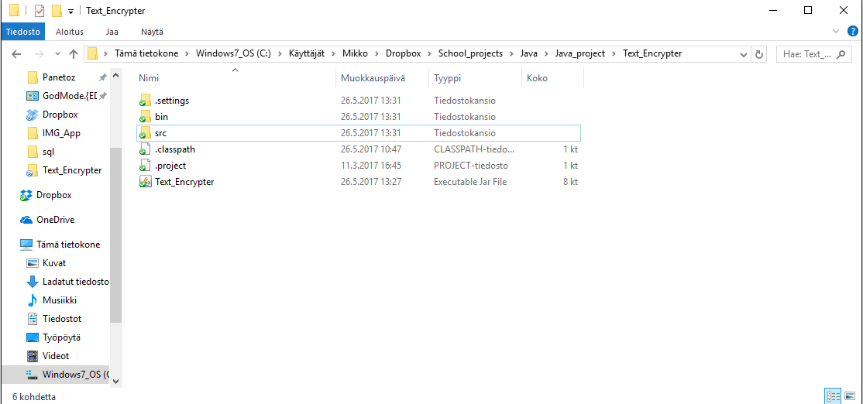
File will be added here once the button is pressed
The Encrypted/Decrypted file which can be saved fill be found here in the applications main folder (If you downloadd this from github the folder name will be Java_OO_project not Text Encrypter)

Slide 5
Screenshots of the App
Click next

Slide 6
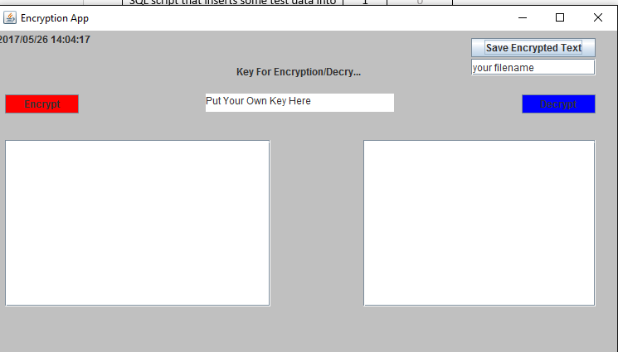
Basic interface

Slide 7

Example of the encryption

Slide 8
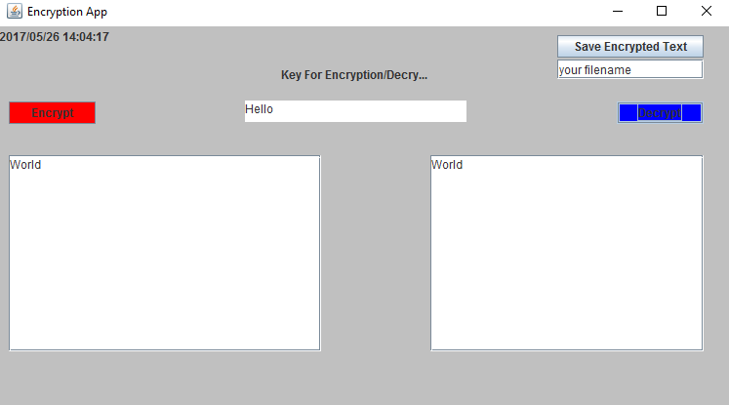
Example of Decryption

Slide 9
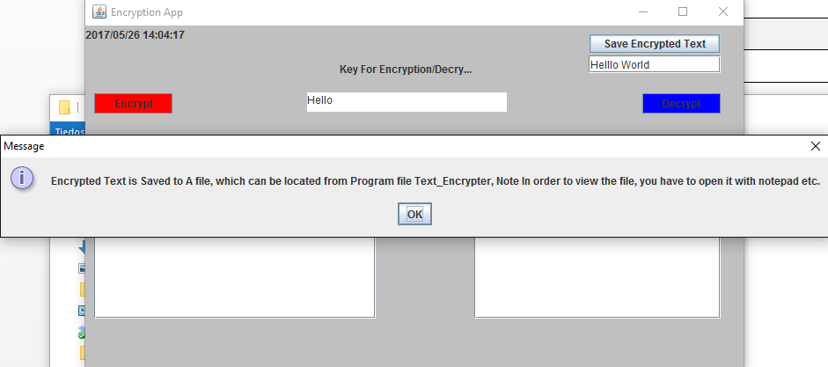
Example of Message that the user can receive

